Slide 1
3. Robot Control
3.1 Fundamentals
3.2 Single-joint Control
3.3 Computed Torque Control
3.3 Lyapunov Stability Analysis
3.5 Adaptive Control
- 1 -

Slide 2
3.5 Adaptive Control
Introduciton
Adaptive Control by Slotine and Li
Adaptive Neural Network (NN) Control of Robots
Unified Adaptive Controller Based on Passivity
Dynamic NN Based Adaptive Control
Example: Adaptive NN control for a Gyro-Mirror System
- 2 -

Slide 3
Introduction
In the discussion of computed torque control, it was noted that often parameters of interest are not known exactly.
When the parameters in the model do not match the parameters of the actual system, servo errors will exist. These servo errors could be used to drive some adaptation schemes which attempt to update the values of the model parameters until the errors disappear.
- 3 -

Slide 4
Introduction
Figure 1: A typical adaptive scheme
- 4 -

Slide 5
Adaptive Control by Slotine and Li
Notations:
, , be the position, velocity and acceleration of the desired trajectory;
be the tracking error;
Then we know that if and as
All these signals shall be used in the control designed later.
- 5 -

Slide 6
Adaptive Control by Slotine and Li
Linear-in-the-parameters Dynamics
Let be the estimated value of .
Let , and correspond to , and , respectively obtained by using as .
(3.5.1)
known regressor of the system
the true robot parameter vector which is unknown usually.
(3.5.2)
- 6 -

Slide 7
Adaptive Control by Slotine and Li
Define for constant .
Equation (3.5.1) and (3.5.2) can be written as
(3.5.3)
(3.5.4)
- 7 -

Slide 8
Problem
Given a robot described by
Show that the closed-loop system is stable if the control is given by
and the parameter adaptation algorithm is
(3.5.5)
(3.5.6)
(3.5.7)
is bounded
Note: The control law (3.5.6) can be re-written as
Stability Analysis?
- 8 -

Slide 9
Proof
Stability Analysis
Two Steps:
Error equation
Stability analysis using Lyapunov's method
Proof:
First Step: Error equation
Closed-loop error equation
[Lips dynamics]
- 9 -

Slide 10
Proof
Substituting the control law
into the above error equation, the C. L. error equation:
Second Step: Stability analysis for the C. L. error equation
Choose the function V as
Therefore, .
[Why 1/2 ?]
- 10 -

Slide 11
Proof
Differentiating V(t) along the closed-loops error equation, we have
Let
- 11 -

Slide 12
Proof
Since V(0) and are positive constants,
Could we claim convergence now?
- 12 -

Slide 13
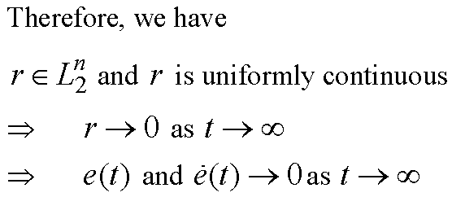
Proof
Since
In addition
from the closed-loop error equation
is uniformly continuous
- 13 -

Slide 14
Structure Diagram
Adaptation Scheme
Robot
Advantages of the Control:
No need for acceleration feedback
Actual system parameters are not needed
Disadvantages:
Requires powerful computing facility
- 14 -

Slide 15
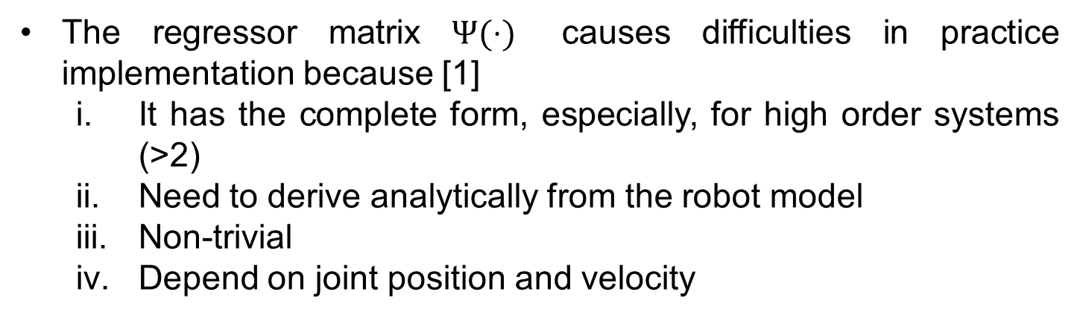
Dynamic NN Based Adaptive Control
The previous controller is designed based on “Regressor based approach”, i.e. the model is rewritten in the form
How can we deal with these difficulties?
- 15 -

Slide 16
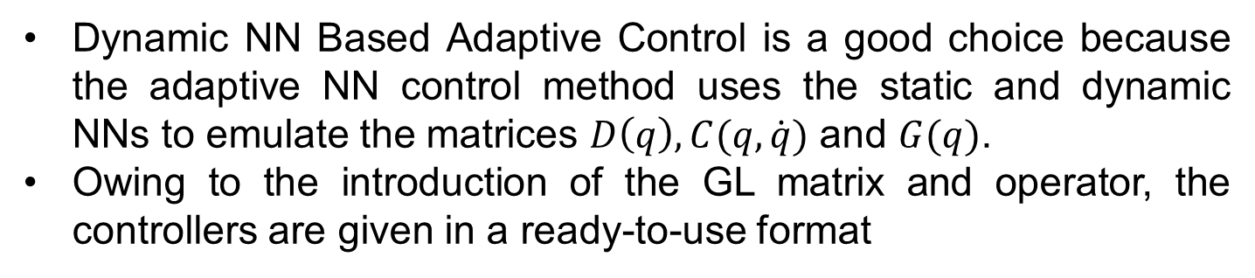

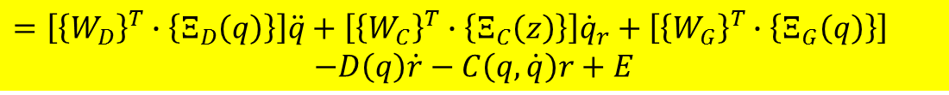

Dynamic NN Based Adaptive Control
We rewrite the model of robots in the following form
where
- 16 -

Slide 17
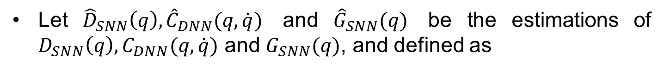
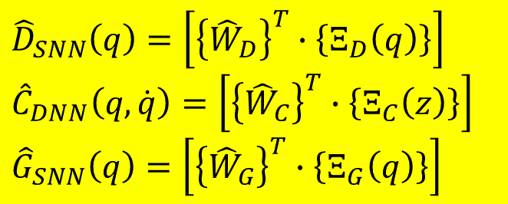

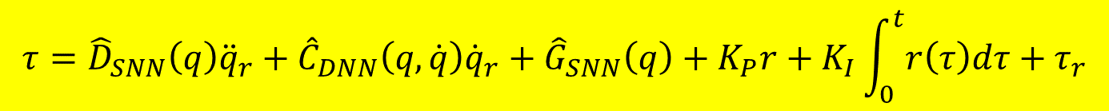
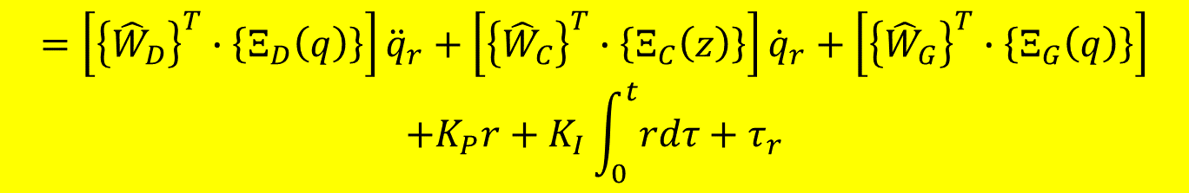
Dynamic NN Based Adaptive Control
The control is proposed as follows
- 17 -

Slide 18
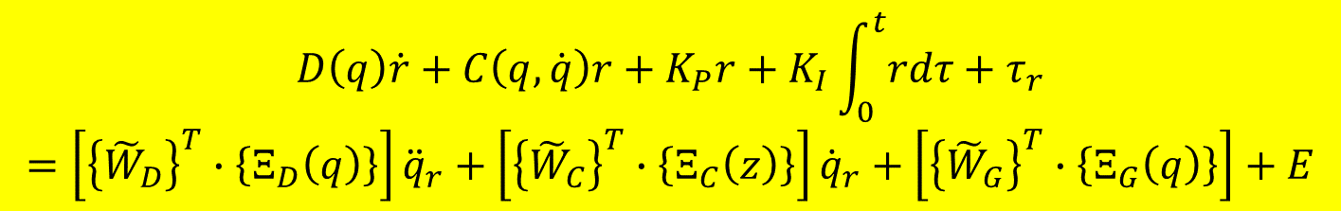


Dynamic NN Based Adaptive Control
The closed-loop error equation has the form
The robust control term is designed as the sliding mode control
- 18 -

Slide 19
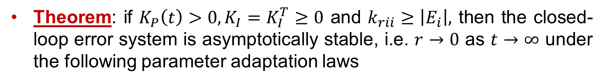
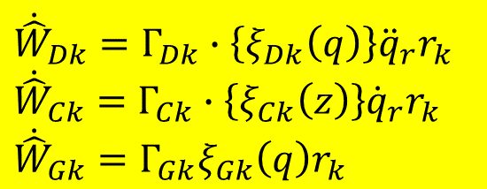
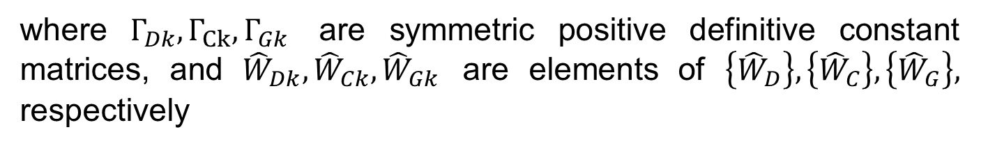
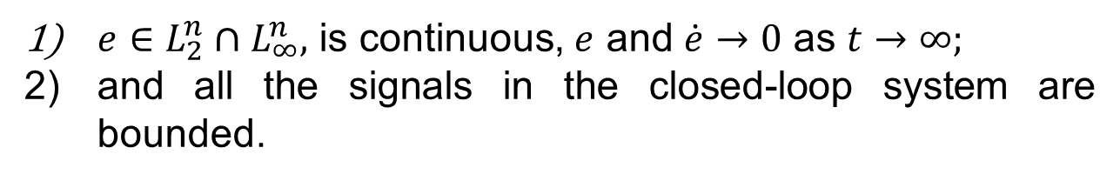
Dynamic NN Based Adaptive Control
Proof: refer to the proof of Theorem 5.2 in [1]
- 19 -

Slide 20
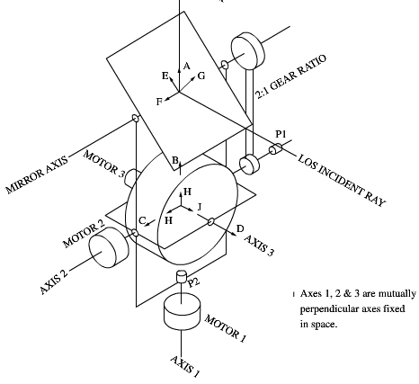

Example
Adaptive NN control for a Gyro-Mirror System
A dynamical model of LOS platform has the form
To Optical Sensor
The system consists of the following components:
a flywheel and its drive;
gimbals that provide two degrees of freedom to the flywheel and torque motors for slewing purposes;
a mirror that is geared to the gimbal through a 2:1 reduction drive mechanism.
Gyro-Mirror line-of-Sight (LOS) system
- 20 -

Slide 21


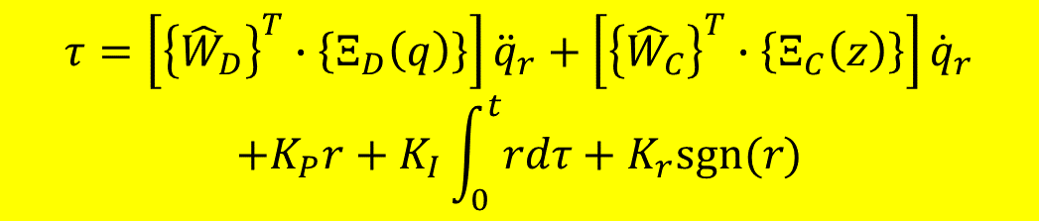
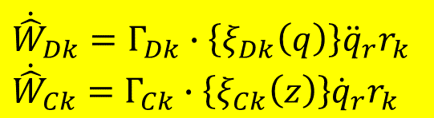
Example
The Control Design：
The control is designed as follows
The update laws have the form
- 21 -

Slide 22
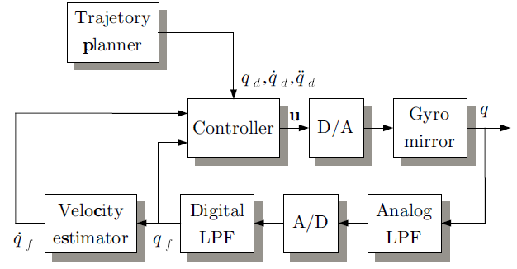
Example
Experimental Set-up
Figure: Block diagram of the gyro-mirror platform
- 22 -

Slide 23
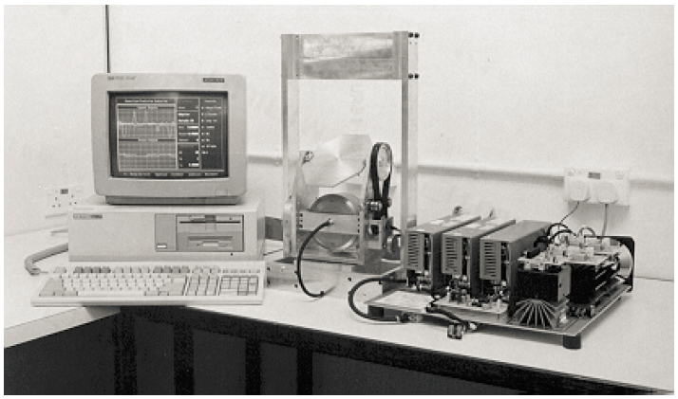
Example
Experimental Set-up
Figure: Photograph of the gyro-mirror platform
- 23 -

Slide 24
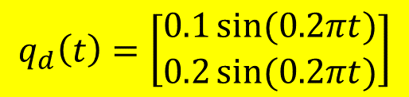
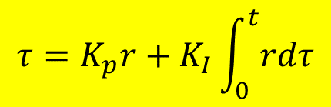
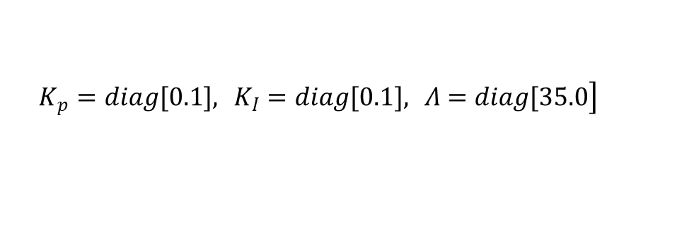
Example
Trajectory Planning
PID-type Control
Where
$$\left.K_{p}=diag[0.1], K_{I}=diag[0.1], Λ=diag[35.0\right]$$
- 24 -

Slide 25
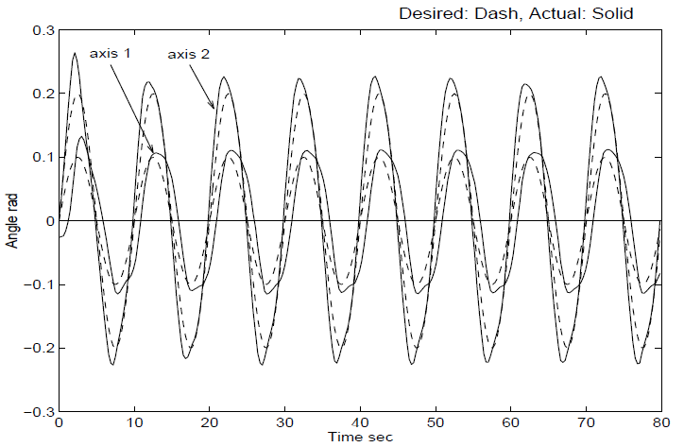
Example
Figure : Position tracking of PID control
- 25 -

Slide 26
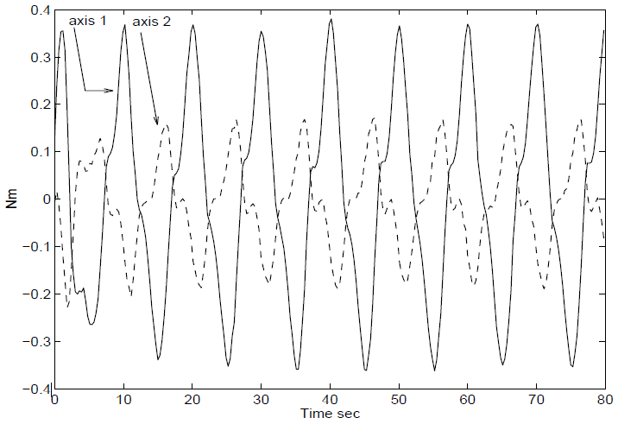
Example
Figure : Control variations of PID control
- 26 -

Slide 27
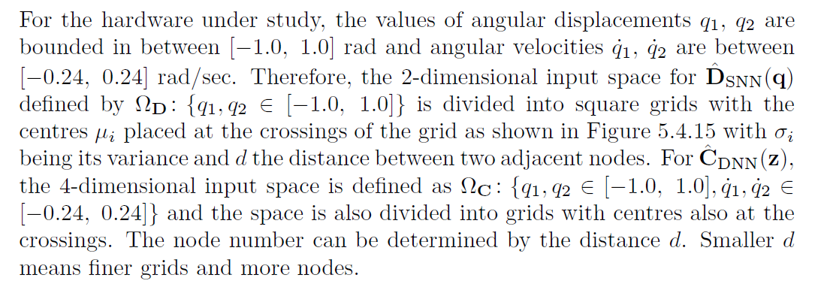
Supplementary Example
Adaptive RBF NN Control:
- 27 -

Slide 28


Supplementary Example
The parameter of RBF NN Control:
Gaussian RBFs –Gains:
Hardy’s multiquadratic RBFs –Gains:
In addition,
- 28 -

Slide 29
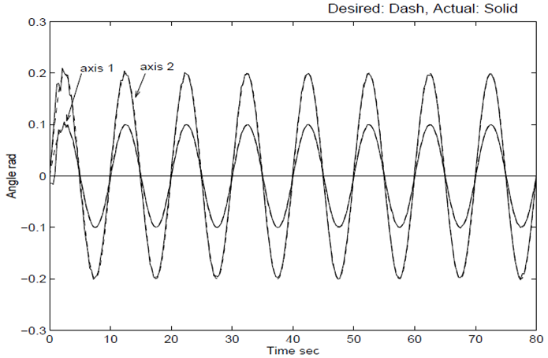
Supplementary Example
Adaptive RBF NN Control：
Figure : Position tracking – Gaussian RBFs
- 29 -

Slide 30
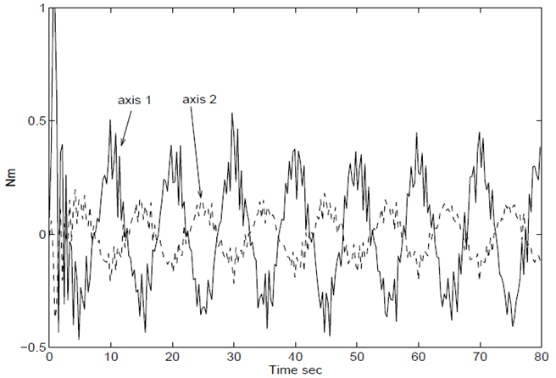
Supplementary Example
Adaptive RBF NN Control：
Figure : Control variations – Gaussian RBFs
- 30 -

Slide 31
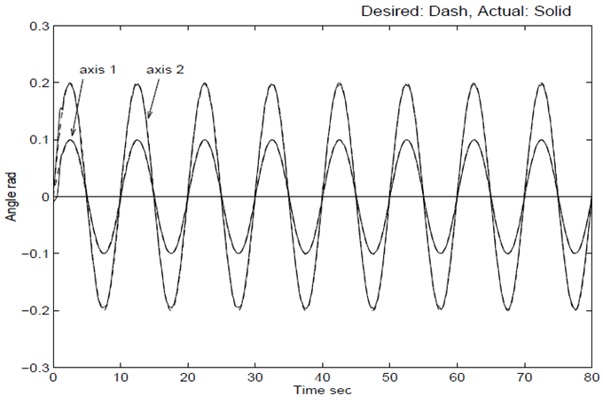
Supplementary Example
RBF NN Based Control：
Figure : Position tracking – Hardy’s multiquadratic RBFs
- 31 -

Slide 32
Tutorial: Problem
Lyapunov based adaptive control
Given
where

Slide 33
Tutorial: Problem
Define , find
Design an adaptive trajectory tracking control based on Lyapunov's 2nd method.

Slide 34
Tutorial: Solution
(a)
Step 1: Decompose the dynamics model
Step 2: Build the LIPS model
- 34 -

Slide 35
Tutorial: Solution
(b)
Design the control law as follows
where , , , , .
Then the parameter adaptation algorithm can be designed as
- 35 -

Slide 36
Tutorial: Solution
Stability analysis:
1) Build the error equation
where .
2) Analysis using Lyapunov's 2nd method
Choose the Lyapunov function as follows
Therefore, .
- 36 -

Slide 37
Tutorial: Solution
Differentiating V(t) along the error equation, we have
- 37 -

Slide 38
Tutorial: Solution
Recall for constant .
When we design the parameter adaptation algorithm as
then
- 38 -

Slide 39
Tutorial: Solution
Since V(0) and are positive constants,
- 39 -

Slide 40
Tutorial: Solution
Since
In addition
from the closed-loop error equation
is uniformly continuous
- 40 -

